Slide 1
Chapter 6: Process Synchronization
Notes:
进程并发
数据共享，不加以控制会导致共享数据的不一致
进程同步

Slide 2
Chapter 6: Process Synchronization
Background
The Critical-Section Problem
Peterson’s Solution
Synchronization Hardware
Semaphores
Classic Problems of Synchronization
Monitors
Synchronization Examples
Notes:
背景
进程互斥，临界区问题，要解决进程互斥就需要解决临界区问题

Slide 3
Objectives
To introduce the critical-section problem, whose solutions can be used to ensure the consistency of shared data
To present both software and hardware solutions of the critical-section problem

Slide 4
Background
Concurrent access to shared data may result in data inconsistency
Maintaining data consistency requires mechanisms to ensure the orderly execution of cooperating processes
Suppose that we wanted to provide a solution to the consumer-producer problem that fills all the buffers. We can do so by having an integer count that keeps track of the number of full buffers. Initially, count is set to 0. It is incremented by the producer after it produces a new buffer and is decremented by the consumer after it consumes a buffer.
Notes:
buffer公共，count公共，
生产者-消费者为两个进程，

Slide 5
Producer
while (true) {
/* produce an item and put in nextProduced*/
while (count == BUFFER_SIZE) ; // do nothing
buffer [in] = nextProduced;
in = (in + 1) % BUFFER_SIZE;
count++;
}
Notes:
整体流程
细分概念介绍

Slide 6
Consumer
while (true) {
while (count == 0)
; // do nothing
nextConsumed= buffer[out];
out = (out + 1) % BUFFER_SIZE;
count--;
/* consume the item in nextConsumed
}
Notes:
整体流程
细分概念介绍

Slide 7
Race Condition
count++ could be implemented as
register1 = count
register1 = register1 + 1
count = register1
count-- could be implemented as
register2 = count
register2 = register2 - 1
count = register2
Consider this execution interleaving with “count = 5” initially:
  S0: producer execute register1 = count {register1 = 5}
  S1: producer execute register1 = register1 + 1 {register1 = 6}
  S2: consumer execute register2 = count {register2 = 5}
  S3: consumer execute register2 = register2 - 1 {register2 = 4}
  S4: producer execute count = register1 {count = 6 }
  S5: consumer execute count = register2 {count = 4}
Notes:
count共享数据资源，生产者-消费者进程并发访问会产生count值不一致
机器指令实现count
producer count+1
consumer count-1
得到不正确状态4，正确为5
4和5颠倒则会变成6

Slide 8
Race Condition
What is a race condition?
  Several processes access and manipulate the same data concurrently
  The result of the execution depends on particular access order.
To avoid race condition, we need to ensure that only one process at a time can be manipulating the same data.----mutual exclusion
Notes:
race condition竞争条件
若干个并发的进程(线程)都可以访问和操纵同一个共享数据,从而执行结果就取决于并发进程对这个数据的访问次序.
为了保证数据的一致性,需要有同步机制来保证多个进程对共享数据的互斥访问.
生产者count++
消费者count--
或者： 消费者count--
生产者count++

Slide 9
Two threads, one counter
Popular web server
Uses multiple threads to speed things up.
Simple shared state error:
  each thread increments a shared counter to track number of hits
What happens when two threads execute concurrently?
…
hits = hits + 1;
…
Notes:
问题？
shared counter，共享数据资源

Slide 10
Shared counters
Possible result: lost update!
One other possible result: everything works.
  ⇒ Difficult to debug
Called a “race condition”
hits = 0
T1
T2
time
read hits (0)
read hits (0)
hits = 0 + 1
hits = 0 + 1
hits = 1
Notes:
问题？

Slide 11
Critical-Section
Critical resource:
  The resource that must be accessed mutual excluded.
Critical section
  A segment of code in which the process is accessing critical resource
  Consider a set of concurrent processes{ P₀,P₁,…,P_{n-1}}.
  Each process has a segment of code, called a critical section, in which the process may be changing common variables, updating a table, writing a file, and so on.
Notes:
进程互斥：转换为临界区问题，
解决进程互斥就需要解决临界区问题
比如之前例子里的count资源

Slide 12
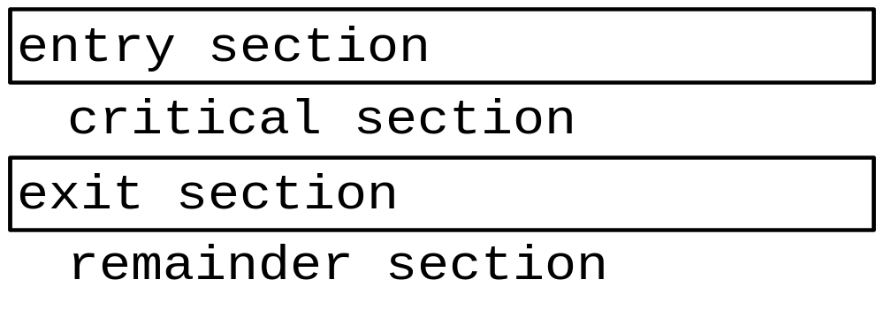
Critical-Section
To ensure the shared data to be modified mutual excluded, no more than one process can execute in its critical section at the same time.
Each process must request permission to enter its critical section----entry section
The remaining code is the remainder section. （知识点）
Notes:
进一步来看临界区的概念
如何解决临界区问题？思路：进入区，退出区
如何设计实现进入区和退出区

Slide 13
Solution to Critical-Section Problem
1. Mutual Exclusion (safety) - No more than one process can be in a critical section at any time.
2. Progress(liveness) - If no process is executing in its critical section and there exist some processes wishing to enter their critical section, then the selection of the processes that will enter the critical section next cannot be postponed indefinitely
3. Bounded Waiting - A bound must exist on the number of times that other processes are allowed to enter their critical sections after a process has made a request to enter its critical section and before that request is granted
  Assume that each process executes at a nonzero speed
  No assumption concerning relative speed of the N processes
Ideally we would like fairness as well
  If two threads are both trying to enter a critical section, they have equal chances of success
  … in practice, fairness is rarely guaranteed（知识点）
Notes:
临界区问题定义
解决临界区问题：进入区，退出区如何实现
后边主要讲解内容
好的设计方案需要满足下列三个性质
互斥(保证安全),
有空让进(保证资源的利用率),
有限等待(防止饥饿)

Slide 14
Critical Section Goals
Threads do some stuff but eventually might try to access shared data
T1
T2
CSEnter();
  Critical section
CSExit();
CSEnter();
  Critical section
CSExit();
time
T1
T2
Notes:
总结，一次过

Slide 15
Critical Section Goals
Perhaps they loop (perhaps not!)
T1
T2
CSEnter();
  Critical section
CSExit();
CSEnter();
  Critical section
CSExit();
T1
T2
Notes:
循环访问

Slide 16
Solving the problem
A first idea:
  Have a boolean flag, inside. Initially false.
  CSEnter()
  {
    while(inside) continue;
    inside = true;
  }
  CSExit()
  {
    inside = false;
  }
Code is unsafe: thread 0 could finish the while test when inside is false, but then 1 might call CSEnter() before 0 can set inside to true!
Now ask:
  Is this Safe? Live? Bounded waiting?
Notes:
开始讲实现临界区的方法：
软件方法
硬件方法
信号量
进入到临界区解决方案，如何设计进入区和退出区，
简单场景，假设有2个线程
首先是软件方法
软件实现临界区的方法，单标志位， true表示占用，false表示不占用
主要是需要实现进入区和退出区，两个线程都使用同样的进入区和退出区

Slide 17
Solving the problem: Take 2
A different idea (assumes just two threads):
  Have a boolean flag, inside[i]. Initially false.
  CSEnter(int i)
  {
    inside[i] = true;
    while(inside[i^1]) continue;
  }
  CSExit(int i)
  {
    Inside[i] = false;
  }
Code isn’t live: with bad luck, both threads could be looping, with 0 looking at 1, and 1 looking at 0
Now ask:
  Is this Safe? Live? Bounded waiting?
Notes:
双标志位方法

Slide 18
Solving the problem: Take 3
Another broken solution, for two threads
  Have a turn variable, turn, initially 1.
  CSEnter(int i)
  {
    while(turn != i) continue;
  }
Code isn’t live: thread 1 can’t enter unless thread 0 did first, and vice-versa. But perhaps one thread needs to enter many times and the other fewer times, or not at all
  CSExit(int i)
  {
    turn = i ^ 1;
  }
Now ask:
  Is this Safe? Live? Bounded waiting?
Notes:
令牌位方法
强制两个线程交替进入临界区，解决了死锁问题

Slide 19
Peterson’s Solution
A classic software-based solution to the critical section problem.
Works for two processes.
The two processes share two variables:
  int turn;
  Boolean flag[2]
The variable turn indicates whose turn it is to enter the critical section.
The flag array is used to indicate if a process is ready to enter the critical section. flag[i] = true implies that process P_{i} is ready!

Slide 20
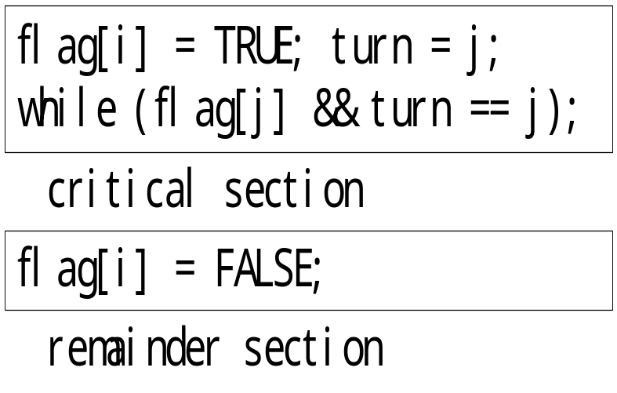
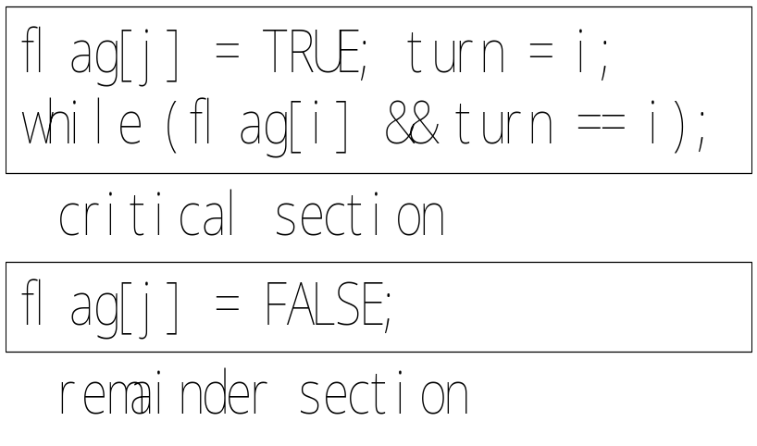
Peterson’s Algorithm
Pi Pj
Notes:
分拆，先讲双标志位，再讲令牌位

Slide 21
Algorithm for Process Pi
while (true) {
flag[i] = TRUE;
turn = j;
while ( flag[j] && turn == j);
CRITICAL SECTION
flag[i] = FALSE;
REMAINDER SECTION
}

Slide 22
Synchronization Hardware
Many systems provide hardware support for critical section code.
Hardware features can make programming task easier and improve system efficiency.
Modern machines provide special atomic hardware instructions to solve critical section problem in a relatively simple manner.
    Atomic = non-interruptable
  Either test memory word and set value
  Or swap contents of two memory words
  (考点：异常，中断，用户态内核态)
Notes:
异常，中断，用户态内核态，进程切换

Slide 23
Solution to Critical-section Problem Using Locks
In general, any solution to critical-section requires a lock in order to prevent race condition.
do {
Acquire lock
critical section
Release lock
Remainder section
} while (true)
Notes:
背后思想是加锁
公共锁
进入区：加锁
退出区：释放锁

Slide 24
TestAndndSetInstruction
Definition:
boolean TestAndSet (boolean *target)
{
boolean rv = *target;
*target = TRUE;
return rv;
}
Notes:
原子性，不可中断

Slide 25
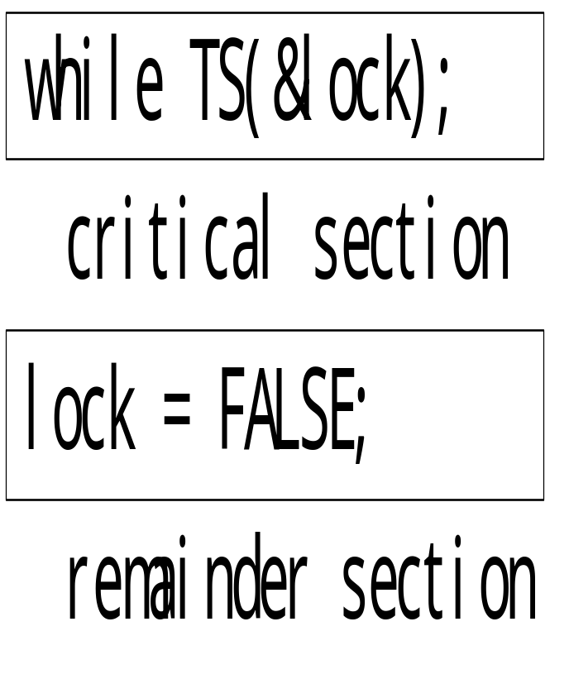
Solution using TestAndSet
Shared boolean variable lock, initialized to false.
Notes:
设定一个共享变量为lock
false表示lock没有被占用，true表示被占用
加锁，
TS 把lock置为true，确保其他进程无法获得锁
释放锁，
TS为原子操作，执行中不可被打断
在进入区利用TS进行检查：有进程在临界区时，重复检查；直到其它进程退出时，检查通过；
在退出区置lock为FALSE

Slide 26
Solution using TestAndSet
Shared boolean variable lock, initialized to false.
Solution:
while (true) {
while ( TestAndSet (&lock ))
; /* do nothing
// critical section
lock = FALSE;
// remainder section
}

Slide 27
Swap Instruction
Definition:
void Swap (boolean *a, boolean *b)
{
boolean temp = *a;
*a = *b;
*b = temp:
}

Slide 28
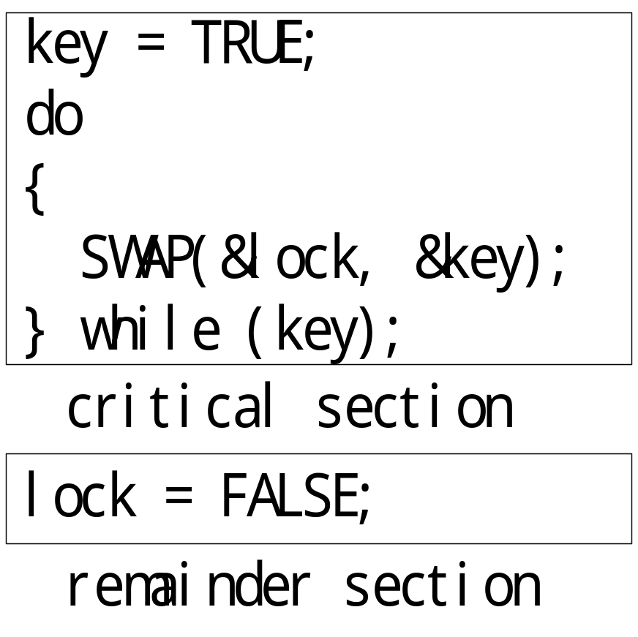
Solution using Swap
Shared Boolean variable lock initialized to FALSE; Each process has a local Boolean variable key.
Notes:
公共，lock: true、false
私有，key: true、false
？？

Slide 29
Solution using Swap
Shared Boolean variable lock initialized to FALSE; Each process has a local Boolean variable key.
Solution:
while (true) {
key = TRUE;
while ( key == TRUE)
Swap (&lock, &key );
// critical section
lock = FALSE;
// remainder section
}

Slide 30
Semaphore
A Semaphore is a special integer variable, it can be accessed only through two standard atomic operations:
  Wait() and Signal()
  Originally called P() and V()
  Wait(S) {
  while S <= 0
  ; // no-op
  S--;
  }
  signal (S) {
  S++;
  }
Notes:
软件实现方法，但是更加便捷
类似锁

Slide 31
Semaphore as General Synchronization Tool
Counting semaphore
  integer value can range over an unrestricted domain
  Can be used to control access to a given resource consisting of a finite number of instances.
Binary semaphore
  integer value can range only between 0 and 1; can be simpler to implement
  Also known as mutex locks
  Provides mutual exclusion
  Semaphore S; // initialized to 1
  wait (S);
  Critical Section
  signal (S);
Notes:
资源进程同步
进程互斥
和之前软件方法比，十分便捷简单

Slide 32
Semaphore Implementation
The main disadvantage of the above semaphore definition is busy waiting which wastes CPU cycles.
  Spinlock
  Process spins while waiting for the lock.
  In a multiprocessor system, spinlock is often used to protect a short code.
Note that applications may spend lots of time in critical sections and therefore this is not a good solution.
Notes:
如何实现？各种问题需要考虑

Slide 33
Semaphore Implementation with no Busy waiting
To overcome busy waiting, we can modify the implementation of semaphore S and the definition of wait() and signal().
Now that a semaphore is a struct.
  a value (of type integer)
  a waiting queue
Two operations:
  block – place the process invoking the operation on the appropriate waiting queue.
  wakeup – remove one of processes in the waiting queue and place it in the ready queue.

Slide 34
Semaphore Implementation with no Busy waiting (Cont.)
Implementation of wait:
wait (S){
value--;
if (value < 0) {
add this process to waiting queue
block(); }
}
Implementation of signal:
Signal (S){
value++;
if (value <= 0) {
remove a process P from the waiting queue
wakeup(P); }
}
Notes:
信号量值可以为负，负数值代表等待进程

Slide 35
Deadlock and Starvation
The implementation of a semaphore with a waiting queue may result in one of the two following situations.
Deadlock – two or more processes are waiting indefinitely for an event that can be caused by only one of the waiting processes
Let S and Q be two semaphores initialized to 1
P₀ P₁
wait (S); wait (Q);
wait (Q); wait (S);
. .
. .
. .
signal (S); signal (Q);
signal (Q); signal (S);
Starvation – indefinite blocking. A process may never be removed from the semaphore queue in which it is suspended.
Notes:
事件主要是指资源释放
如果没有等待队列是否也有死锁问题？

Slide 36
AND Semaphore
Swait(S1, S2, …, Sn)
{
while (TRUE)
{
if (S1 >=1 && S2 >= 1 && … && Sn >= 1)
{
for (i = 1; i <= n; ++i) --Si;
break;
}
else
{ add the process to Sj.queue //no available resource to use and S_{j} is the first semaphore of which value is less than 1 ;
block();
}
}
}
Notes:
解决方案，
思想：
wait操作和signal操作进行了修改
判断所有请求信号量能否满足，能满足才请求占用，否则都不占用，不会出现占用一部分的情况

Slide 37
AND Semaphore
Ssignal(S1, S2, …, Sn)
{
for (i = 1; i <= n; ++i)
{
++Si; //release resources；
for (each process P waiting in Si.queue)
//check if there is some process waiting；
{
remove a process P from Si.queue;
if (Swait(S1, S2, …, Sn) )
//different from signal, P will be waken up when it acquires all resources ；
{ //all needed resources are available；
wakeup(P);
}
else
{ //otherwise；
add process P to another waiting queue；
}
}
}
}

Slide 38
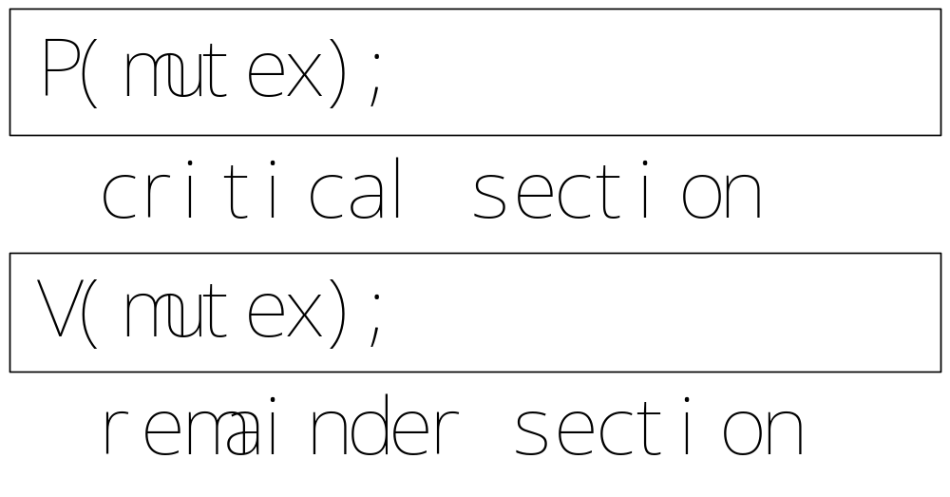
Mutual exclusion using semaphore
  Semaphore mutex ; // initialized to 1
Notes:
设为1

Slide 39
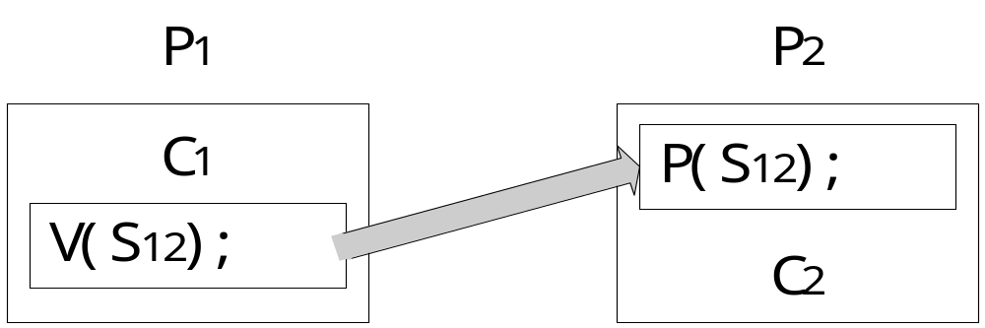
Synchronization using semaphore
Consider two concurrently running processes P1 and P2, P1 with a statement C1 and P2 with a statement C2. suppose we require that C2 be executed only after C1 has completed
We can define a common semaphore S12, initialized to 0.
Notes:
设为0

Slide 40
Example 1
S₂
d
a
e
S₅
h
b
j
S₁
S₃
S₇
S₈
f
i
c
S₆
g
S₄
Notes:
前驱图
每个点：一个进程
每条边：边两端的进程有前后执行关系
如何利用信号量实现前驱图？
每个边设置一个信号量

Slide 41
Struct
smaphore a,b,c,d,e,f,g,h,I,j=0,0,0,0,0,0,0,0,0,0
cobegin
{S1;V(a);V(b);V(c);}
{P(a);S2;V(d);}
{P(b);S3;V(e);V(f);}
{P(c);S4;V(g);}
{P(d);P(e);S5;V(h);}
{P(f);P(g);S6;V(i)}
{P(h);P(i);S7;V(j);}
{P(j);S8;}
coend

Slide 42
Example 2
（A²+3B）/(B+5A),若A,B已赋值，
试画出该公式求值过程的前趋图。

Slide 43
开始
S1:x1=A*A
S2:x2=3*B
S3:x3=5*A
S4:x4=x1+x2
S5:x5=B+x3
S₁
S₂
S₃
S6:x6=x4/x5
结束
S₄
S₅
（A2+3B）/(B+5A)
S₆
Notes:
每个运算抽象为一个进程，有的进程无依赖关系，有的进程有依赖关系

Slide 44
Classical Problems of Synchronization
Bounded-Buffer Problem
Readers and Writers Problem
Dining-Philosophers Problem

Slide 45

Bounded-Buffer Problem
Problem:
  producer puts things into a shared buffer
  Consumer takes them out
  Need synchronization for coordinating producer and consumer
Notes:
生产者，消费者：进程
这些进程需要对共享缓冲区操作，因此需要进程同步机制来保证操作的正确性

Slide 46

Bounded-Buffer Problem
Coke machine example:
  delivery person (producer) fills machine with cokes
  students (consumer) feed cokes and drink them
  coke machine has finite space (buffer)

Slide 47
Producer-Consumer Problem
Bounded buffer: size ‘N’（知识点）
  Access entry 0… N-1, then “wrap around” to 0 again
Producer process writes data to buffer
  Must not write more than ‘N’ items more than consumer “ate”
Consumer process reads data from buffer
  Should not try to consume if there is no data
0
1
N-1
In
Out
Notes:
定义：
多个生产者进程
多个消费者进程
共享in指针
共享out指针

Slide 48
Bounded-Buffer Problem
N buffers, each can hold one item
Semaphore mutex initialized to the value 1
Semaphore full initialized to the value 0
Semaphore empty initialized to the value N.
Notes:
信号量：几种？如何用？
对于不同种类的进程，
buffer是有限的，所以需要记录可用资源
in和out：临界资源，mutex互斥使用
生产者进程：full资源
消费者进程：empty资源
对这两种资源分别设置信号量，联合起来使用，支持资源进程同步

Slide 49
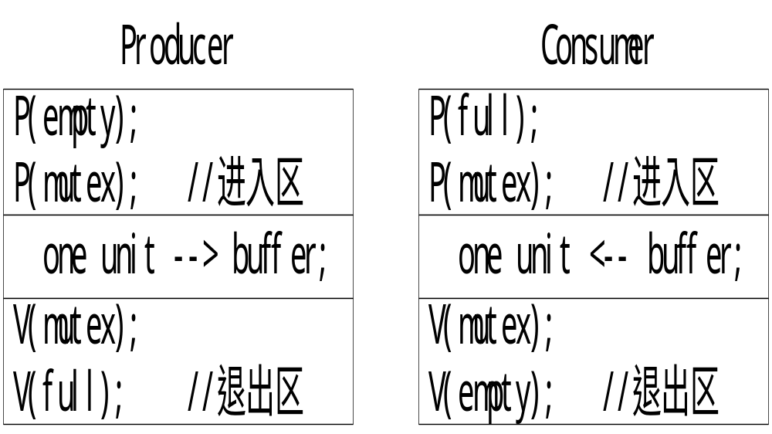
The structure of Producer/Consumer process
Notes:
两种信号量用法：
互斥 PV在同一个进程里
同步 PV在不同的进程里
进程同步，同一个信号量的PV操作分开使用
同步如何用？不加会怎样？
生产者
进入区的P如何用？退出区的V如何用？
消耗者
进入区的P如何用？退出区的V如何用？

Slide 50
Bounded Buffer Problem (Cont.)
The structure of the producer process
while (true) {
// produce an item
wait (empty);
wait (mutex);
// add the item to the buffer
signal (mutex);
signal (full);
}

Slide 51
Bounded Buffer Problem (Cont.)
The structure of the consumer process
while (true) {
wait (full);
wait (mutex);
// remove an item from buffer
signal (mutex);
signal (empty);
// consume the removed item
}

Slide 52
Bounded-Buffer Problem
public class BoundedBuffer {
public BoundedBuffer() { /* see next slides */ }
public void enter() { /* see next slides */ }
public Object remove() { /* see next slides */ }
private static final int BUFFER_SIZE = 2;
private Semaphore mutex;
private Semaphore empty;
private Semaphore full;
private int count, in, out;
private Object[] buffer;
}
Notes:
面向对象方法，封装，
进入区：调用enter
离开区：调用remove
细节封装
count：公共指针，buffer里的可用资源数

Slide 53
Bounded Buffer Constructor
public BoundedBuffer() {
// buffer is initially empty
count = 0;
in = 0;
out = 0;
buffer = new Object[BUFFER_SIZE];
mutex = new Semaphore(1);
empty = new Semaphore(BUFFER_SIZE);
full = new Semaphore(0);
}
Notes:
初始化方法

Slide 54
enter() Method
public void enter(Object item) {
empty.P();
mutex.P();
// add an item to the buffer
++count;
buffer[in] = item;
in = (in + 1) % BUFFER_SIZE;
mutex.V();
full.V();
}

Slide 55
remove() Method
public Object remove() {
full.P();
mutex.P();
// remove an item from the buffer
- - count;
Object item = buffer[out];
out = (out + 1) % BUFFER_SIZE;
mutex.V();
empty.V();
return item;
}
Notes:
补充：count临界资源
生产者和消费者使用同样的互斥信号量

Slide 56
What’s wrong?
Init: Semaphore mutex = 1; /* for mutual exclusion*/
Semaphore empty = N; /* number empty buf entries */
Semaphore full = 0; /* number full buf entries */
any_t buf[N];
int tail = 0, head = 0;
Oops! Even if you do the correct operations, the order in which you do semaphore operations can have an incredible impact on correctness
Producer
void put(char ch) {
wait(mutex);
wait (empty);
// add ch to buffer
buf[head%N] = ch;
head++;
signal(mutex);
signal (full );
}
Consumer
char get() {
wait (full );
wait (mutex);
// remove ch from buffer
ch = buf[tail%N];
tail++;
signal (mutex);
signal (empty);
return ch;
}
What if buffer is full?
Notes:
思考：

Slide 57
Discussion about Bounded Buffer Solution
Why asymmetry?
  Producer does: wait (empty), signal(full)
  Consumer does: wait (full), signal(empty)
Is order of wait ’s important?
  Yes! Can cause deadlock
Is order of signal’s important?
  No, except that it might affect scheduling efficiency
What if we have 2 producers or 2 consumers?
  Do we need to change anything?
Notes:
总结
思考：empty和full？并发问题？

Slide 58





Readers-Writers Problem
W
R
R
R
Motivation: Consider a shared database
  Two classes of users:
    Readers – never modify database
    Writers – read and modify database

Slide 59
Readers-Writers Problem
Problem – allow multiple readers to read at the same time. Only one single writer can access the shared data at the same time.
Shared Data
  Data set
  Semaphore Rmutex initialized to 1.
  Semaphore Wmutex initialized to 1.
  Integer readcount initialized to 0.
Notes:
读写互斥
写写互斥
读读不互斥
信号量初始值置为1，用于互斥

Slide 60
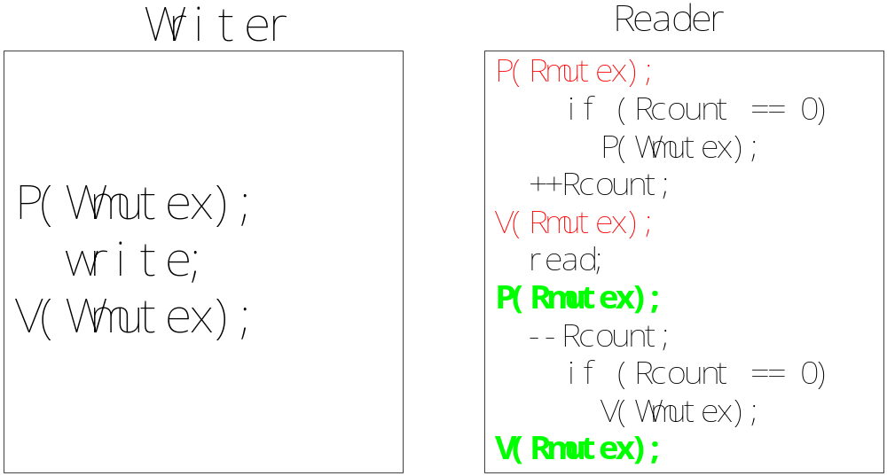
Readers-Writers Problem
Notes:
左边，写写互斥
右边，读写互斥，count为零时P操作，表示第一个读者开始读了，
一旦P以后写者就不能再写了，读写互斥
然而后续的读者可以继续读，读读不互斥
count为零时V操作，表示所有读者已经结束阅读，可以写了
Rcount需要互斥
总结： dataset临界资源，W信号量互斥；Rcount临界资源，R信号量互斥

Slide 61
The structure of the Writer/Reader process(con.)
Shared variables: Semaphore mutex, wrl;
integer readcount;
Init: mutex = 1, wrl = 1, readcount = 0;
公平性
Writer
do {
wait(wrl);
. . .
/*writing is performed*/
. . .
signal(wrl);
}while(TRUE);
Reader
do {
wait (mutex);
readcount++;
if (readcount == 1) wait (wrl);
signal(mutex);
. . .
/*reading is performed*/
. . .
wait (mutex);
readcount--;
if (readcount == 0) signal(wrl);
signal(mutex);
}while(TRUE);

Slide 62
Readers-Writers Problem: Reader
public class Reader extends Thread {
public Reader(Database db) {
server = db;
}
public void run() {
int c;
while (true) {
c = server.startRead();
// now reading the database
c = server.endRead();
}
}
private Database server;
}
Notes:
面向对象实现方法：
database类型的类，以database类型的对象DB为输入，对server进行实例化
细节
封装思想
把通用功能封装成类，每次直接调用类方法即可，不需要重新写代码

Slide 63
Readers-Writers Problem: Writer
public class Writer extends Thread {
public Writer(Database db) {
server = db;
}
public void run() {
while (true) {
server.startWrite();
// now writing the database
server.endWrite();
}
}
private Database server;
}
Notes:
主方法？初始化？

Slide 64
Readers-Writers Problem (cont)
public class Database
{
public Database() {
readerCount = 0;
mutex = new Semaphore(1);
db = new Semaphore(1);
}
public int startRead() { /* see next slides */ }
public int endRead() { /* see next slides */ }
public void startWrite() { /* see next slides */ }
public void endWrite() { /* see next slides */ }
private int readerCount; // number of active readers
Semaphore mutex; // controls access to readerCount
Semaphore db; // controls access to the database
}

Slide 65
startRead() Method
public int startRead() {
mutex.P();
++readerCount;
// if I am the first reader tell all others
// that the database is being read
if (readerCount == 1)
db.P();
mutex.V();
return readerCount;
}

Slide 66
endRead() Method
public int endRead() {
mutex.P();
--readerCount;
// if I am the last reader tell all others
// that the database is no longer being read
if (readerCount == 0)
db.V();
mutex.V();
return readerCount;
}

Slide 67
Writer Methods
public void startWrite() {
db.P();
}
public void endWrite() {
db.V();
}

Slide 68
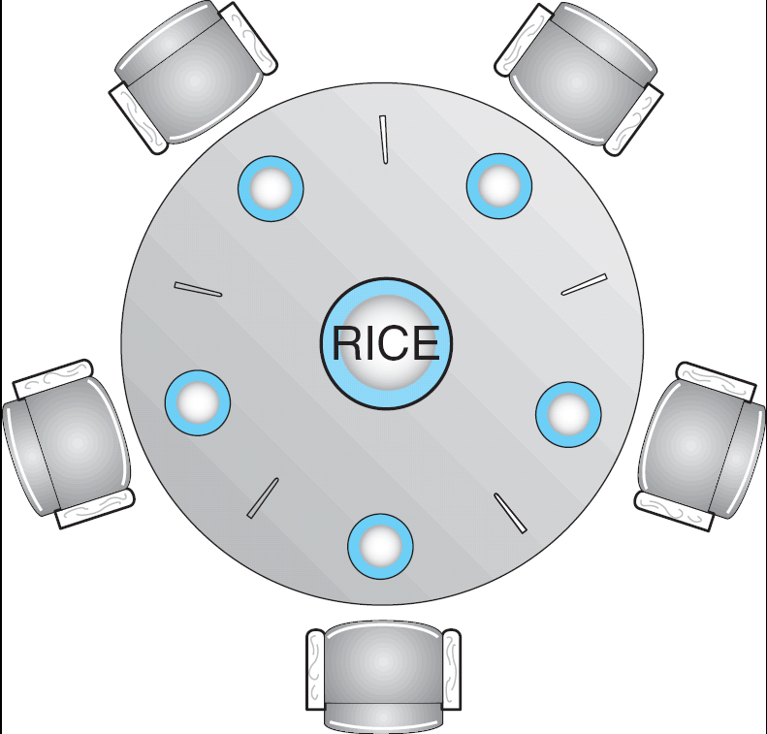
Dining-Philosophers Problem
Shared data
  Bowl of rice (data set)
  Semaphore chopstick [5] initialized to 1
Notes:
5个哲学家，5个进程；
资源
5个筷子。信号量互斥访问；

Slide 69
Dining-Philosophers Problem (Cont.)
The structure of Philosopher i:
    While (true) {
    wait ( chopstick[i] );
    wait ( chopStick[ (i + 1) % 5] );
    // eat
    signal ( chopstick[i] );
    signal (chopstick[ (i + 1) % 5] );
    // think
    }
    Deadlock?

Slide 70
Solution2：AND semaphore
Var chopstick array[0,…,4] of semaphore :=(1,1,1,1,1);
Processi
Reeat
think;
Swait (chopstick[(I+1) mod 5],chopstick[I]);
Eat;
Ssignal (chopstick[(I+1) mod 5],chopstick[I]);
Until false;

Slide 71
Discussion about Semaphores
The value of a semaphore represents the number of available resource
  S>0: there are S available resources
  S=0: all resources are being used
  S<0: there are |S| processes waiting for the resource
Operations can be done to a semaphore S:
  Initialization: >=0
  Wait(): request a resource
  signal (): release a resource
Notes:
回顾

Slide 72
Discussion about Semaphores( Cont.)
Either wait(S) or signal(S) can not be omitted
  For mutual exclusion: they appear in the same process
  For synchronization: they appear in different process respectively
For two successive wait(S1) and wait(S2) in a process, the order is important. If S1 is for synchronization, and S2 is for mutual exclusion, then
  The correct order is wait(S1) ; wait(S2)
  If they are written in the order wait(S2) ;wait(S1) , there would be a deadlock.
Notes:
先锁再同步：同步可能需要对方配合，锁住后对方无法操作，产生死锁

Slide 73
信号量小结
1、信号量的含义
  S>0：信号量所表示资源的可用个数；
  S=0：信号量所表示资源的可用个数为0；
  S<0：在S信号量上因等待该类资源而阻塞的进程个数；
2、P()/V()操作的使用
  使用S所表示的资源时用P(S)；
  释放S所表示的资源时用V(S)；
3、互斥问题：设置一个公共信号量S且初值为1，表示只有一个互斥资源可用；
同步问题：根据每个进程使用的资源类型情况分别设置各自的私有信号量和初值。
Notes:
纯同步
资源同步

Slide 74
Exercise
吃水果问题
桌上有一只盘子，每次只能放一个水果，爸爸向盘中放苹果或桔子，儿子专等吃盘里的桔子，女儿专等吃盘里的苹果。只要盘子空，则爸爸可向盘中放水果，仅当盘中有自己需要的水果时，儿子或女儿可从中取出.
请给出三人之间的同步关系，并用P、V操作实现三人正确活动的程序。

Slide 75
分析:此问题实际上是生产者-消费者问题的一个变形
  生产者:爸爸
  消费者：女儿、儿子
  缓冲区：盘子（SIZE=1）
解答：设置3个信号量：
  empty=1,实现盘子是否可用，实现与女儿/儿子的同步
  S1=0,表示盘中是否有苹果，实现爸爸与女儿的同步
  S2=0,表示盘中是否有桔子，实现爸爸与儿子的同步
Notes:
简化：
缓冲区为1，共有3个进程
思路：各自独立编写流程，资源抽象，设定信号量判定同步还是互斥
解题思路：简化：先考虑爸爸和儿子

Slide 76
吃水果问题
儿子：P（S2）；
  从盘中取桔子；
  V（ empty ）；
  吃桔子
爸爸：
  P（empty);
  将水果放入盘中；
  IF桔子 V（S2）
  else V（S1）
女儿： P（S1）;
从盘中取苹果;
V（ empty ）;
吃苹果
Notes:
信号量互斥
纯同步
设置单一信号量，初值为1
资源同步
各自设置私有信号量
Mutex顺序？

Slide 77
Problems with Semaphores
Although semaphores provide a convenient and effective mechanism for process synchronization, using them incorrectly can result in timing errors.
Correct use of semaphore operations:
  signal (mutex) …. wait (mutex)
  wait (mutex) … wait (mutex)
  Omitting of wait (mutex) or signal (mutex) (or both)
Notes:
信号量机制是解决进程互斥、同步的有效工具，但前提是（1）信号量设置、（2）其初值的确定以及（3）相关进程中安排P,V操作的位置必须正确，否则同样也会造成与时间有关的错误，有时甚至造成死锁。

Slide 78
Monitors
A high-level abstraction that provides a convenient and effective mechanism for process synchronization
Only one process may be active within the monitor at a time
    monitor monitor-name
    {
    // shared variable declarations
    procedure P1 (…) { …. }
    …
    procedure Pn (…) {……}
    Initialization code ( ….) { … }
    …
    }
    }

Slide 79
Monitors
A programming language construct
A collection of procedures, variables, data structures
Access to it is guaranteed to be exclusive.
  By the compiler (not programmer)
Monitors use separate mechanisms for the two types of synchronization
  use locks for mutual exclusion
  use condition variables for ordering constraints
monitor = a lock + the condition variables associated with that lock
Notes:
管程的定义：一个管程定义了一个数据结构和能为并发进程调用的在该数据结构上的一组操作过程，这组互斥操作的过程，能同步进程和改变管程中的数据。
如何lock？

Slide 80
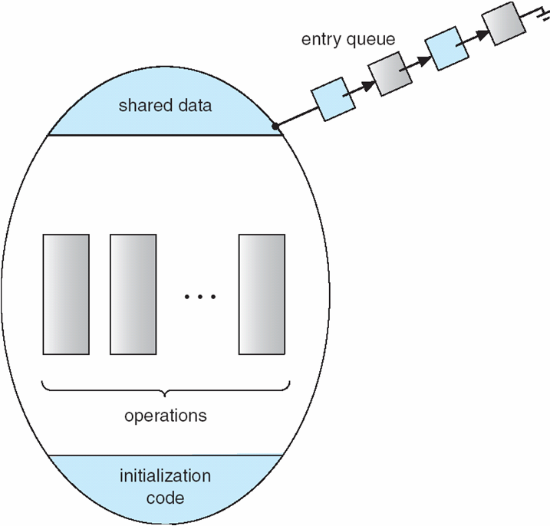
Schematic view of a Monitor
Notes:
Only one process may be active within the monitor at a time？

Slide 81
Condition Variables
Main idea:
  make it possible for thread to sleep inside a critical section
Approach:
  by atomically releasing lock, putting thread on wait queue and go to sleep
Each variable has a queue of waiting threads
  threads that are sleeping, waiting for a condition（知识点：概念，为什么需要管程）
Notes:
？？

Slide 82
Condition Variables
condition x, y;
Two operations on a condition variable:
  x.wait () – a process that invokes the operation is
  suspended.
  x.signal () – resumes one of processes (if any) that
  invoked x.wait ()
Notes:
每个条件变量都需要在管程中说明
条件变量没有具体取值

Slide 83

Monitor with Condition Variables
Notes:
？？

Slide 84
Producer Consumer using Monitors
Monitor Producer_Consumer {
any_t buf[N];
int n = 0, tail = 0, head = 0;
condition full, empty;
void put(char ch) {
if(n == N) empty.wait();
buf[head%N] = ch;
head++;
n++;
full.signal();
}
char get() {
if(n == 0) full.wait();
ch = buf[tail%N];
tail++;
n--;
empty.signal();
return ch;
}
}
What if no thread is waiting
when signal is called?
Signal is a “no-op” if nobody
is waiting. This is very different
from what happens when you call
signal () on a semaphore – semaphores
have a “memory” of how many times
signal() was called!
Notes:
？？
以item为输入

Slide 85
Producer Consumer using Monitors
producer : begin
repeat
produce an item in nextp ;
Producer_Consumer.put ( item) ;
until false ;
end
consumer : begin
repeat
Producer_Consumer.get (item) ;
consume the item in nextc ;
until false ;
end

Slide 86
Solution to Dining Philosophers
monitor DP
{
enum { THINKING; HUNGRY, EATING } state [5] ;
condition self [5];
void pickup (int i) {
state[i] = HUNGRY;
test(i);
if (state[i] != EATING) self [i].wait;
}
void putdown (int i) {
state[i] = THINKING;
// test left and right neighbors
test((i + 4) % 5);
test((i + 1) % 5);
}
Notes:
？？
以哲学家序号i为输入条件

Slide 87
Solution to Dining Philosophers (cont)
void test (int i) {
if ( (state[(i + 4) % 5] != EATING) &&
(state[i] == HUNGRY) &&
(state[(i + 1) % 5] != EATING) ) {
state[i] = EATING ;
self[i].signal () ;
}
}
initialization_code() {
for (int i = 0; i < 5; i++)
state[i] = THINKING;
}
}
Notes:
？？

Slide 88
Solution to Dining Philosophers (cont)
Each philosopher I invokes the operations pickup()
and putdown() in the following sequence:
dp.pickup (i)
EAT
dp.putdown (i)

Slide 89
Synchronization Examples
Solaris
Windows XP
Linux
Pthreads
JAVA

Slide 90
Solaris Synchronization
Implements a variety of locks to support multitasking, multithreading (including real-time threads), and multiprocessing
Uses adaptive mutexes for efficiency when protecting data from short code segments.
Uses condition variables and readers-writers locks when longer sections of code need access to data.
Uses turnstiles to order the list of threads waiting to acquire either an adaptive mutex or a reader-writer lock.
Notes:
turnstile是等待队列，包含阻塞在锁上的线程

Slide 91
Solaris Synchronization
adaptive mutex is used to protect critical data
On a multiprocessor system
  spinlock
    If the lock is held by a thread currently running on another CPU, the thread spins while waiting for the lock to become available
  Not spin
    If the thread holding the lock is not running, the thread blocks until the releasing of the lock.
On a single-processor system
  The thread holding the lock is never running if the lock is tested by another thread, so threads always sleep rather than spin if they encounter a lock.
Notes:
The thread holding the lock is never running？

Slide 92
Solaris Synchronization
Reader-writer locks are used to protect data that are accessed frequently but are usually accessed in a read-only manner.
More efficient than semaphore
Used on only long sections of code.

Slide 93
Windows XP Synchronization
For kernel thread
  Uses interrupt masks to protect access to global resources on uniprocessor systems
  Uses spinlocks on multiprocessor systems
For user thread
  provides dispatcher objects which may act as mutexes, semaphores and events
  An event acts much like a condition variable
  An event may notify a waiting thread when a desired condition occurs.
Notes:
Uses interrupt masks to protect access to global resources on uniprocessor systems？
kernel thread，user thread？

Slide 94
Linux Synchronization
Prior to version 2.6, Linux was a nonpreemptive kernel, meaning that a process running in kernel mode could not be peempted.
Now the Linux kernel is fully preempted.
Linux kernel provides:
  Semaphores
    For single processor system
  spin locks
    For SMP
Notes:
SMP？

Slide 95
Java Synchronization
Synchronized, wait(), notify() statements
Multiple Notifications
Block Synchronization
Java Semaphores
Notes:
（多重声明）

Slide 96
Java Synchronization
Synchronized statements
Every object in JAVA has associated with it a single lock.
When a method is declared as synchronized, calling the method requires owning the lock for the object.
Entry set:
  the set of threads waiting for the lock to become available.
Notes:
在JAVA中，每个对象都与一把锁相关联。
当一个方法声明为“同步的”，那么调用这个方法就需要拥有该对象的锁。
如果对象的锁已被别的线程拥有，那么调用同步方法的线程进入该对象锁的入口等待队列(entry set )中。
当线程退出了同步方法时锁就会释放.

Slide 97
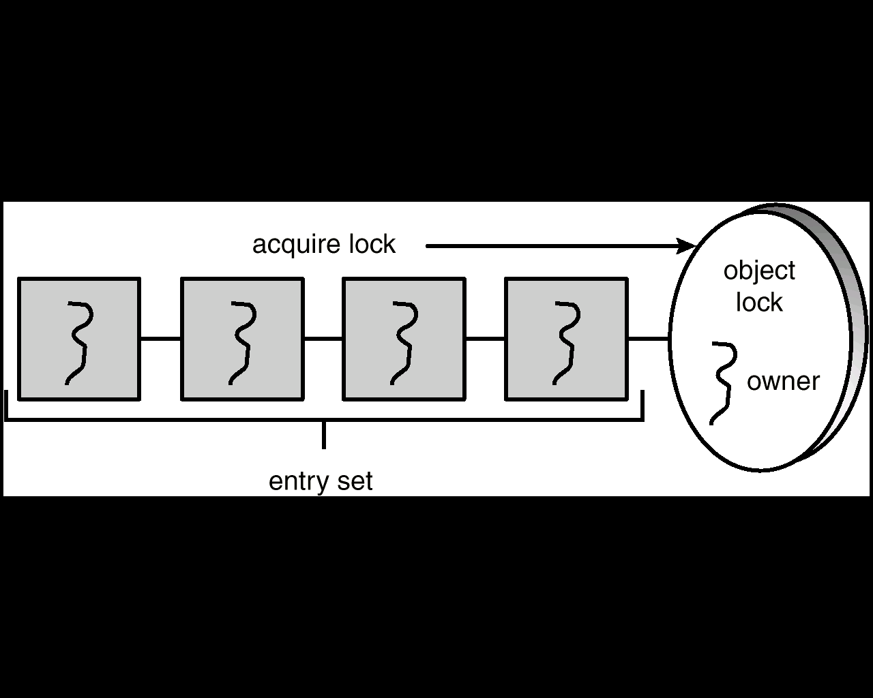
Entry Set
Notes:
Owner？

Slide 98
synchronized enter() Method
public synchronized void enter(Object item) {
while (count == BUFFER_SIZE)
Thread.yield();
++count;
buffer[in] = item;
in = (in + 1) % BUFFER_SIZE;
}
Notes:
Thread.yield()？

Slide 99
synchronized remove() Method
public synchronized Object remove() {
Object item;
while (count == 0)
Thread.yield();
--count;
item = buffer[out];
out = (out + 1) % BUFFER_SIZE;
return item;
}
Notes:
Thread.yield()？

Slide 100
Java Synchronization
Producer-consumer problem:
  The object BoundedBuffer has one lock
  A producer must acquire the lock before invoking method enter().
  When the lock is owned by a producer, if a consumer want to invoke remove(), it has to block until the producer exits the method enter() and release the lock.
  This ensure mutual exclusion.
Notes:
当

Slide 101
Java Synchronization
However, lock ownership has led to another problem.
Assume that the buffer is full and the consumer is sleeping.
If the producer calls enter(), it will be allowed to continue because the lock is available. When the producer invokes enter(), it sees a full buffer and performs the yield(), but it still owns the lock for the object.
When the consumer awakens and try to call remove(), it will block because it does not own the lock.
This leads to deadlock.

Slide 102
Java Synchronization
Solution:
  In addition to having a lock, every object also has a wait set.
  Two new methods: wait() and notify().
If the producer calls enter() and the buffer is full, it will release the lock by invoking wait(), and enter to the wait set for the object.
So the consumer can acquire the lock and call remove(), and then awake the producer by notify().

Slide 103
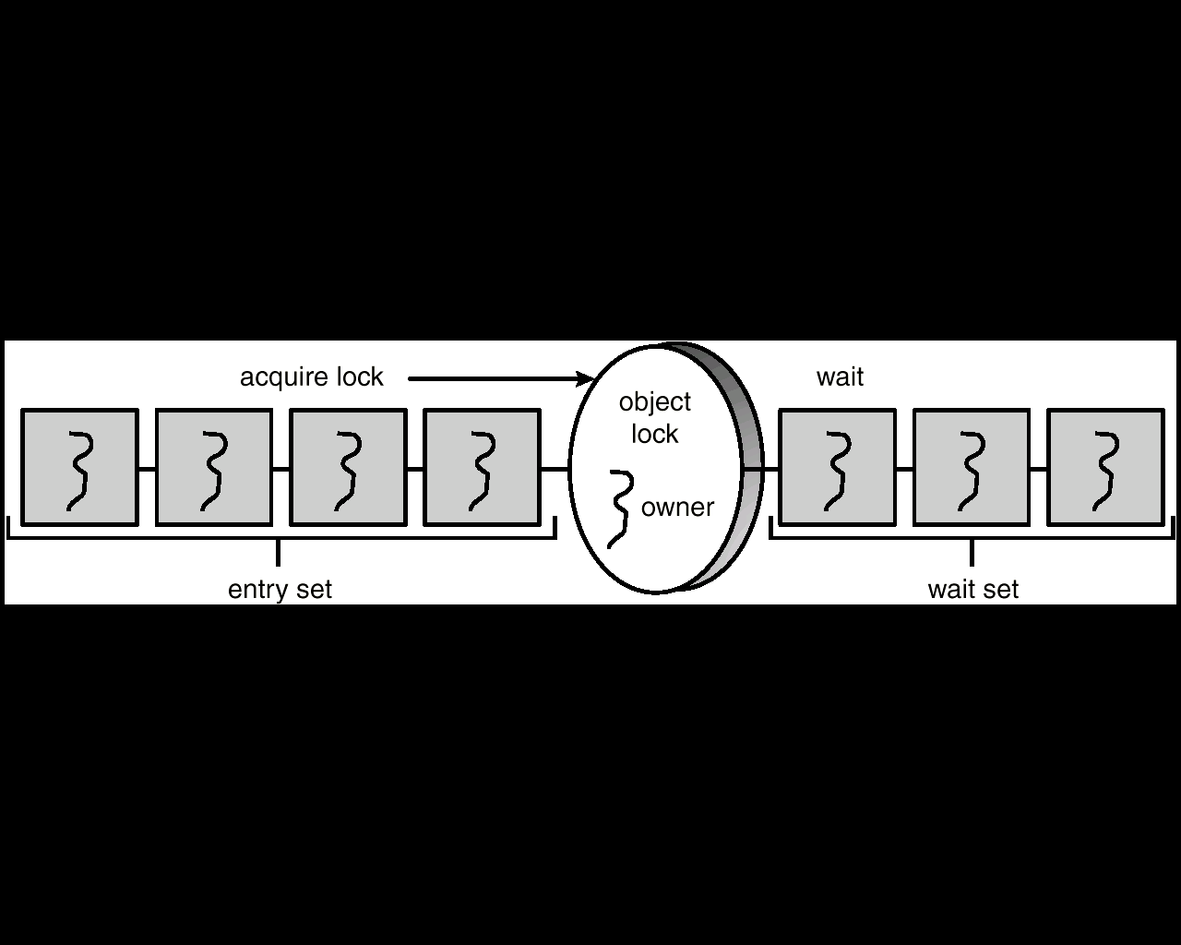
Entry and Wait Sets

Slide 104
The wait() Method
When a thread calls wait(), the following occurs:
- the thread releases the object lock.
- thread state is set to blocked.
- thread is placed in the wait set

Slide 105
The notify() Method
When a thread calls notify(), the following occurs:
- selects an arbitrary thread T from the wait set
- moves T to the entry set.
- sets T to Runnable.
T can now compete for the object’s lock again

Slide 106
enter() with wait/notify Methods
public synchronized void enter(Object item) {
while (count == BUFFER_SIZE)
try {
wait();
}
catch (InterruptedException e) { }
}
++count;
buffer[in] = item;
in = (in + 1) % BUFFER_SIZE;
notify();
}
Notes:
Try？Wait？Notify？

Slide 107
remove() with wait/notify Methods
public synchronized Object remove() {
Object item;
while (count == 0)
try {
wait();
}
catch (InterruptedException e) { }
--count;
item = buffer[out];
out = (out + 1) % BUFFER_SIZE;
notify();
return item;
}

Slide 108
Multiple Notifications
notify() selects an arbitrary thread T from the wait set
If there are multiple threads in wait set and more than one condition for which to wait, it is possible to have another deadlock.
例：有5个线程T1，T2，T3，T4，T5，一个共享变量turn，5个线程都需要调用dowork()方法，规定只有编号与turn相同的线程才能进入dowork()。假定turn=3， T1，T2，T4在等待集中， T3在调用dowork()。当T3完成了它的工作，它把turn设为4，并调用notify()。 notify()从等待集中任意选取一个线程，假设选中了T2，但当T2恢复运行后检查条件时，发现turn并不是它的值，于是T2再次调用wait(),进入等待集。接下来，如果T3，T5调用dowork()，也会进入等待集。这样，5个线程都进入了等待集，形成了死锁。
Notes:
T2再次调用wait()后应该继续调用notify？

Slide 109
Multiple Notifications
notify() selects an arbitrary thread from the wait set. This may not be the thread that you want to be selected.
notifyAll() removes ALL threads from the wait set and places them in the entry set. This allows the threads to decide among themselves who should proceed next.

Slide 110
The Readers-Writers Problem
JAVA solution to reader-writer problem：
  readerCount： number of readers
  dbReading： is set to true if the database is currently being read
  dbWriting： is set to true if the database is currently being written
  startRead()、endRead ()、startWrite ()、endWritet (): are all declared as synchronized to ensure mutual exclusion th the shared variables.

Slide 111
Reader Methods with Java Synchronization
public class Database {
public Database() {
readerCount = 0;
dbReading = false;
dbWriting = false;
}
public synchronized int startRead() { /* see next slides */ }
public synchronized int endRead() { /* see next slides */ }
public synchronized void startWrite() { /* see next slides */ }
public synchronized void endWrite() { /* see next slides */ }
private int readerCount;
private boolean dbReading;
private boolean dbWriting;
}

Slide 112
startRead() Method
public synchronized int startRead() {
while (dbWriting == true) {
try {
wait();
}
catch (InterruptedException e) { }
++readerCount;
if (readerCount == 1)
dbReading = true;
return readerCount;
}

Slide 113
endRead() Method
public synchronized int endRead() {
--readerCount
if (readerCount == 0)
dbReading = false;
notifyAll();
return readerCount;
}

Slide 114
Writer Methods
public void synchronized startWrite() {
while (dbReading == true || dbWriting == true)
try {
wait();
}
catch (InterruptedException e) { }
dbWriting = true;
}
public void synchronized endWrite() {
dbWriting = false;
notifyAll();
}

Slide 115
Block Synchronization
Blocks of code – rather than entire methods – may be declared as synchronized
This yields a lock scope that is typically smaller than a synchronized method
Object mutexLock = new Object();
. . .
public void someMethod() {
// non-critical section
synchronized(mutexLock) {
// critical section
}
// non-critical section
}
Notes:
？？

Slide 116
Java Semaphores
Java does not provide a semaphore, but a basic semaphore can be constructed using Java synchronization mechanism

Slide 117
Semaphore Class
public class Semaphore {
public Semaphore() {
value = 0;
}
public Semaphore(int v) {
value = v;
}
public synchronized void P() { /* see next slide */ }
public synchronized void V() { /* see next slide */ }
private int value;
}

Slide 118
P() Operation
public synchronized void P() {
while (value <= 0) {
try {
wait();
}
catch (InterruptedException e) { }
}
value --;
}

Slide 119
V() Operation
public synchronized void V() {
++value;
notify();
}

Slide 120
Java Synchronization rules
a thread that owns the lock for an object can enter another synchronized method for the same object.
a thread can nest synchronized method invocations for different objects. thus, a thread can simultaneously own the lock for several different objects
Notes:
nest

Slide 121
Java Synchronization rules(Cont.)
if a method is not declared as synchronized, then it can be invoked regardless of lock ownership, even while another synchronized method for the same object is executing.
if the wait set for an object is empty, then a call to notify() or notifyall() has no effect.

Slide 122
assignment
  6.9
  6.10
  6.2

Slide 123
End of Chapter 6

